Slide 1

Oyindamola apampa
Class algorithm projects

Slide 2
Pseudocode for project 1
Start
MOVE one space towards east
PICK flower
MOVE two spaces towards south
PLANT flower
MOVE one space towards east
Stop

Slide 3
Pseudocode for project 2
Start
List1 = {john, jack, James, ….Mary}
Name = input(‘enter name:’ )
if Name is in List1,
Print (‘welcome’)
else,
Print(‘get out’)
End

Slide 4
Pseudocode for project 3
Start
Weight = (input weight)
Location = (input location)
if
weight >= 10
and
Location = Epe
Print (price is 5000 naira)
If
weight < 10
and
Location = Epe
Then
Print(price is 4000 naira)
If
weight >= 10
and
Location = Pau
Then
Print(price is 2000 naira)
If
weight < 10
and
Location = Pau
Then
Print(price is 1500 naira)
End

Slide 5
Pseudocode for project 4
Start
Grade = (“a “, “b”, “c”)
Jambscore = “input jamb score”
English = “input English grade”
Math = “input math grade”
Physics = “input physics grade”
Chemistry = “input chemistry grade”
Fmath = “input F.math grade”
if jambscore > 229 and English in Grade and Math in Grade and Physics in Grade and chemistry in Grade
And Fmath in Grade
Print ( “valid result”)
Else:
Print (“invalid result)

Slide 6
Pseudocode for project 5
Start
Boy turns towards south
Walks two steps towards south
Gives flower to girl
Girl turns towards east
Walks three steps towards east
Plants flower
Walks two steps south
Faces east
End

Slide 7
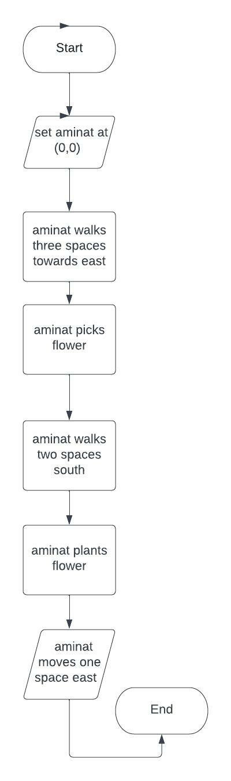
Flowchart for project 1

Slide 8
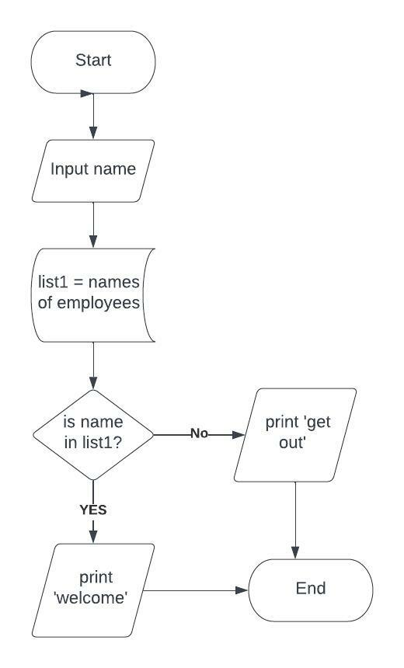
Flowchart for project 2

Slide 9
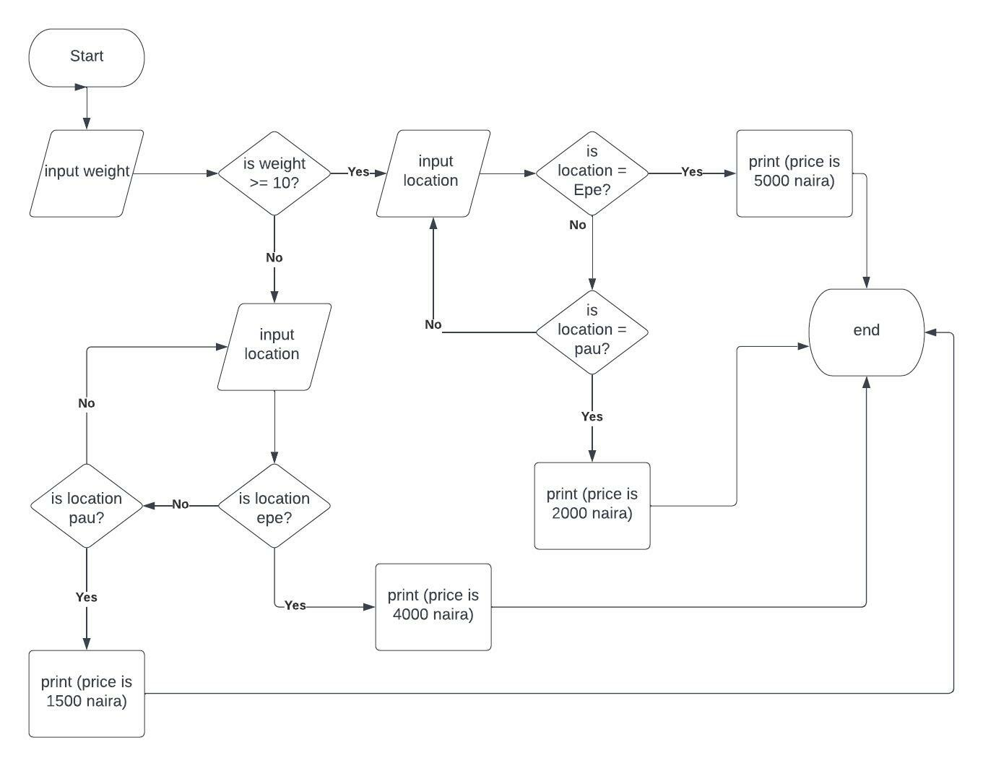
Flowchart for project 3

Slide 10
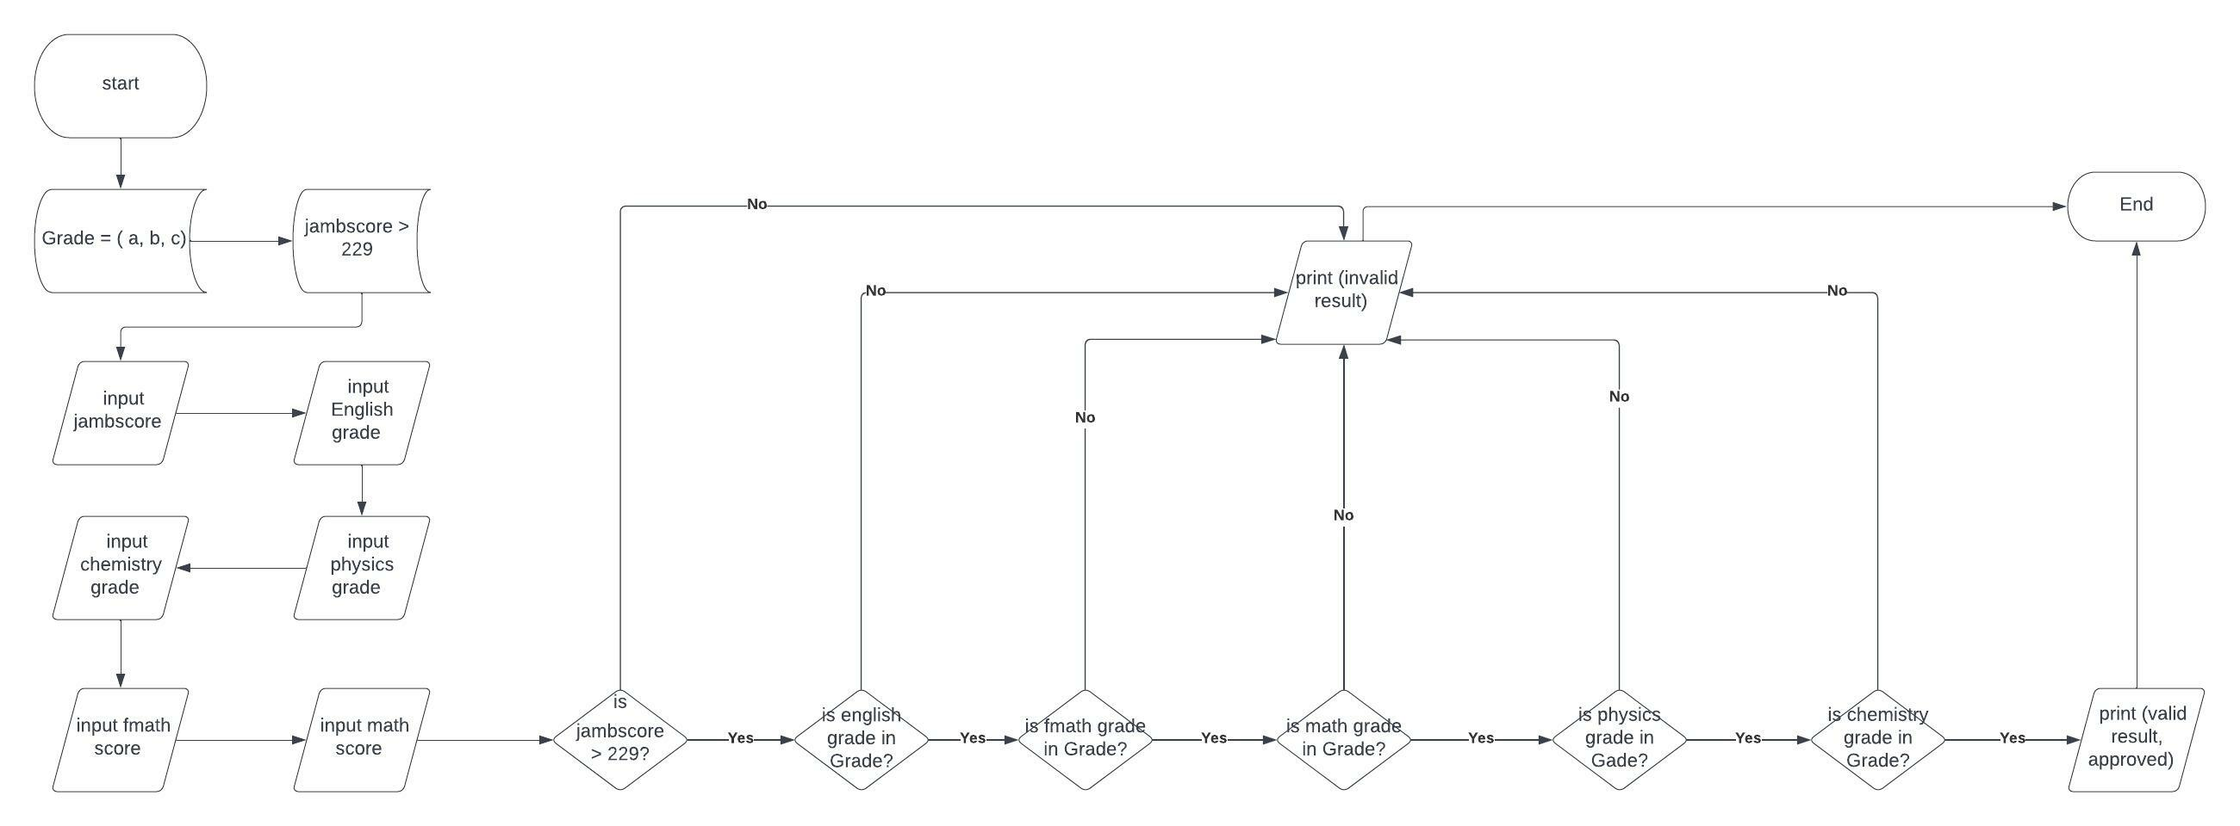
Flowchart for project 4

Slide 11
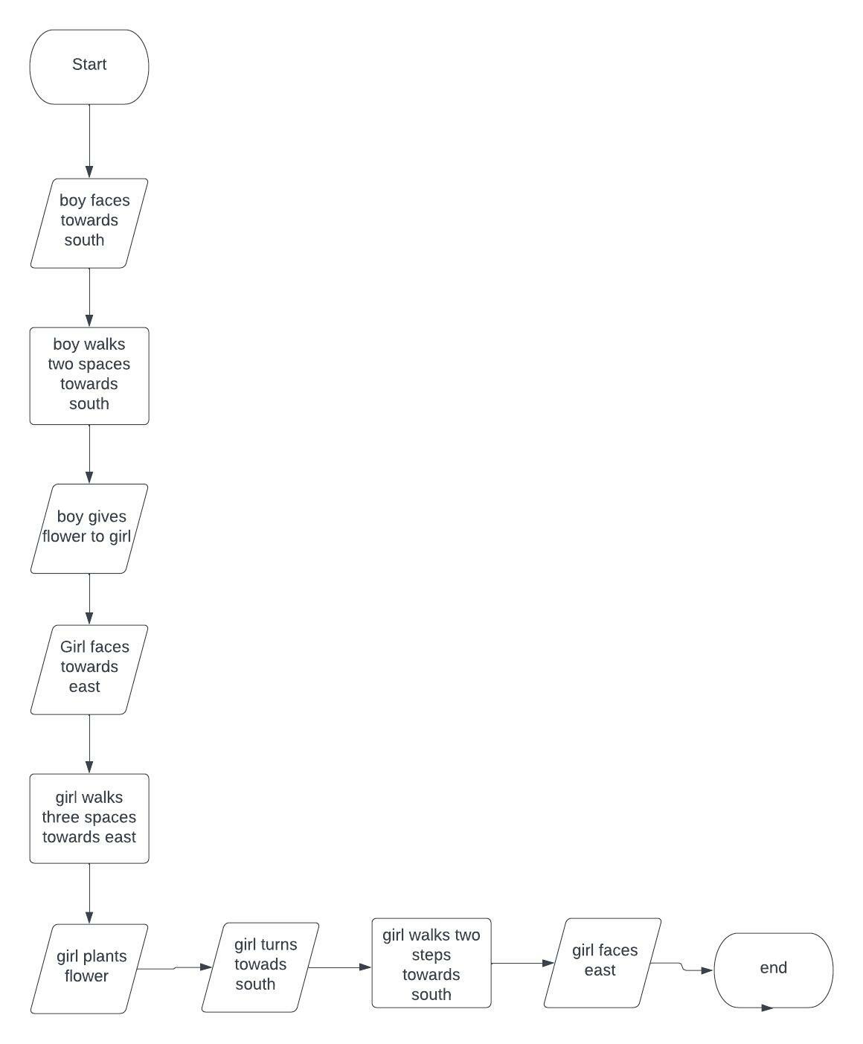
Flowchart for project 5

